Slide 1
Backpropagation

Slide 2
Deep Learning
The last theory topic we will cover is backpropagation.
We’ll start by building an intuition behind backpropagation, and then we’ll dive into the calculus and notation of backpropagation.

Slide 3
Deep Learning
Fundamentally, we want to know how the cost function results changes with respect to the weights in the network, so we can update the weights to minimize the cost function

Slide 4
Deep Learning
Let’s begin with a very simple network, where each layer only has 1 neuron

Slide 5
Deep Learning
Each input will receive a weight and bias
w1 +b1
w2 +b2
w3 +b3

Slide 6
Deep Learning
This means we have:
C(w1,b1,w2,b2,w3,b3)
w1 +b1
w2 +b2
w3 +b3

Slide 7
Deep Learning
We’ve already seen how this process propagates forward.
Let’s start at the end to see the backpropagation.
w1 +b1
w2 +b2
w3 +b3

Slide 8
Deep Learning
Let’s say we have L layers, then our notation becomes:
L-n
L-2
L-1
L

Slide 9
Deep Learning
Focusing on these last two layers, let’s define z=wx+b
Then applying an activation function we’ll state: a = σ(z)
L-1
L

Slide 10
Deep Learning
This means we have:
z^{L} = w^{L} a^{L-1} +b^{L}
L-1
L

Slide 11
Deep Learning
This means we have:
z^{L} = w^{L} a^{L-1} +b^{L}
a^{L} = σ(z^{L})
L-1
L

Slide 12
Deep Learning
This means we have:
z^{L} = w^{L} a^{L-1} +b^{L}
a^{L} = σ(z^{L})
C₀(...) =(a^{L} - y)²
L-1
L

Slide 13
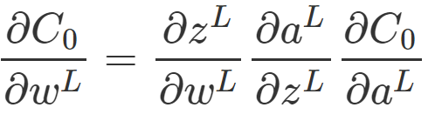
Deep Learning
We want to understand how sensitive is the cost function to changes in w:
L-1
L

Slide 14
Deep Learning
Using the relationships we already know along with the chain rule:
L-1
L

Slide 15
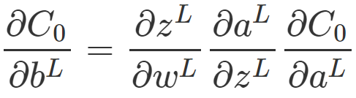

Deep Learning
We can calculate the same for the bias terms:
L-1
L

Slide 16
Deep Learning
The main idea here is that we can use the gradient to go back through the network and adjust our weights and biases to minimize the output of the error vector on the last output layer.

Slide 17
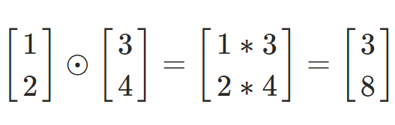
Deep Learning
Using some calculus notation, we can expand this idea to networks with multiple neurons per layer.
Hadamard Product

Slide 18
Deep Learning
Given this notation and backpropagation, we have a few main steps to training neural networks.
Note! You do not need to fully understand these intricate details to continue with the coding portions.

Slide 19
Deep Learning
Step 1: Using input x set the activation function a for the input layer.
z = w x +b
a = σ(z)
This resulting a then feeds into the next layer (and so on).

Slide 20
Deep Learning
Step 2: For each layer, compute:
z^{L} = w^{L} a^{L-1} +b^{L}
a^{L} = σ(z^{L})

Slide 21
Deep Learning
Step 3: We compute our error vector:
δ^{L}=∇_{a}C⊙σ′(z^{L})

Slide 22
Deep Learning
Step 3: We compute our error vector:
δ^{L}=∇_{a}C⊙σ′(z^{L})
∇_{a}C=(a^{L}−y)
Expressing the rate of change of C with respect to the output activations

Slide 23
Deep Learning
Step 3: We compute our error vector:
δ^{L}=(a^{L}−y)⊙σ′(z^{L})

Slide 24
Deep Learning
Step 3: We compute our error vector:
δ^{L}=(a^{L}−y)⊙σ′(z^{L})
Now let’s write out our error term for a layer in terms of the error of the next layer (since we’re moving backwards).
Font Note: lowercase L
Font Note: Number 1

Slide 25
Deep Learning
Step 4: Backpropagate the error:
For each layer: L−1,L−2,… we compute (note the lowercase L (l)):
δ^{l}=(w^{l+1})^{T}δ^{l+1}⊙σ′(z^{l})
(w^{l+1})^{T} is the transpose of the weight matrix of l+1 layer

Slide 26
Deep Learning
Step 4: Backpropagate the error:
This is the generalized error for any layer l:
δ^{l}=(w^{l+1})^{T}δ^{l+1}⊙σ′(z^{l})
(w^{l+1})^{T} is the transpose of the weight matrix of L+1 layer

Slide 27
Deep Learning
Step 4: When we apply the transpose weight matrix, (w^{l+1})^{T} we can think intuitively of this as moving the error backward through the network, giving us some sort of measure of the error at the output of the lth layer.

Slide 28
Deep Learning
Step 4: We then take the Hadamard product ⊙σ′(z^{l}). This moves the error backward through the activation function in layer l, giving us the error δ^{l} in the weighted input to layer l.

Slide 29
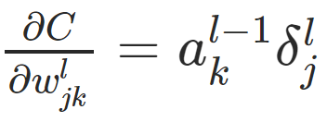
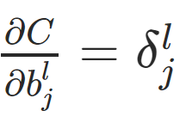
Deep Learning
The gradient of the cost function is given by:
For each layer: L−1,L−2,… we compute

Slide 30
Deep Learning
This then allows us to adjust the weights and biases to help minimize that cost function.

